Slide 1
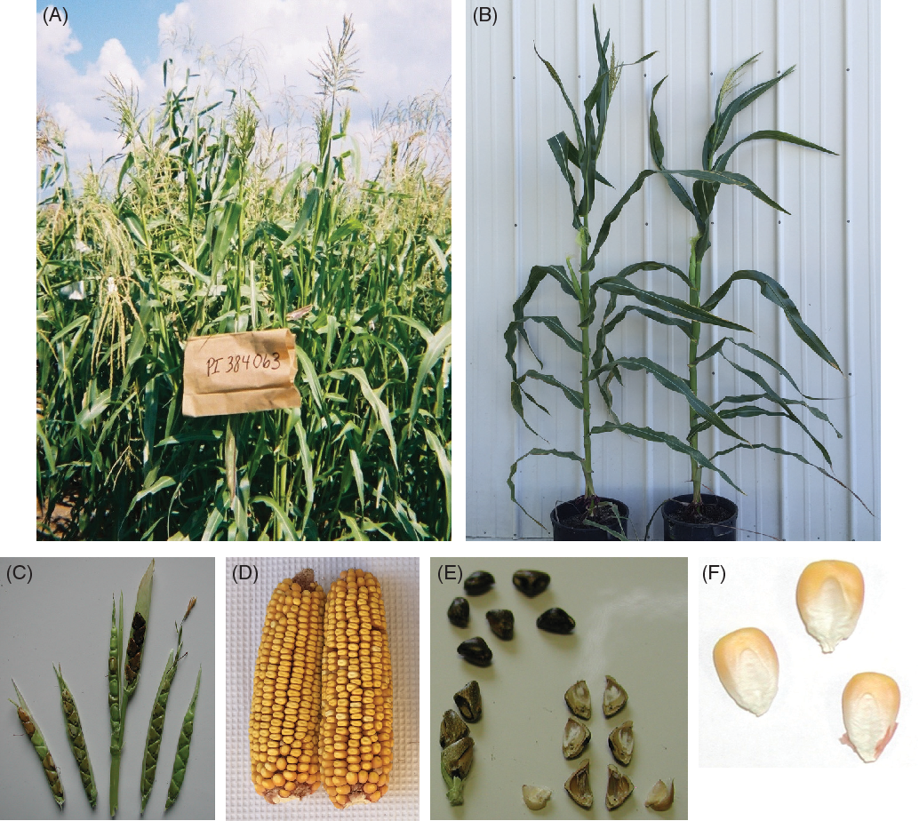
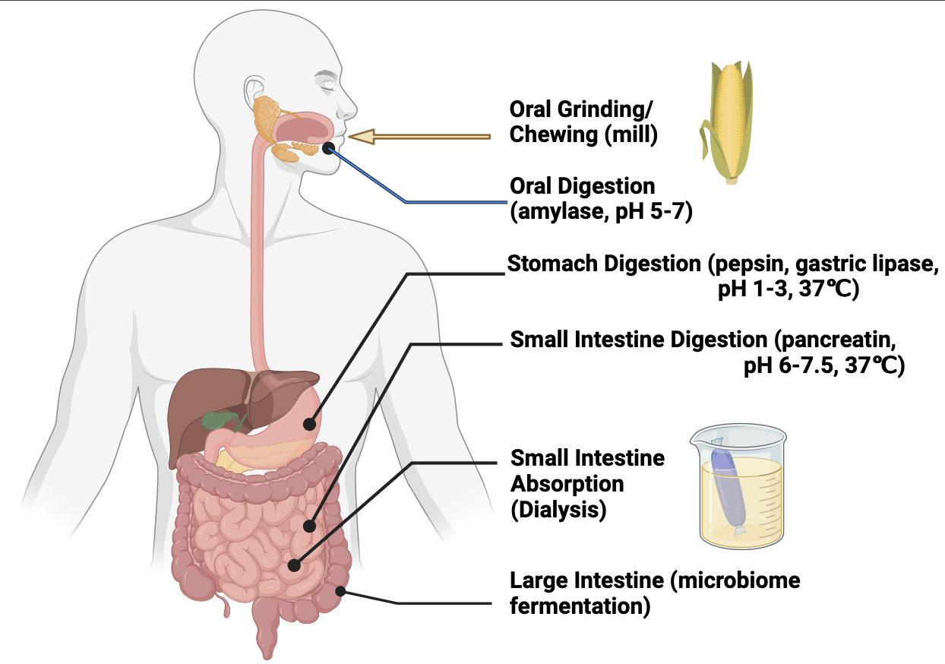
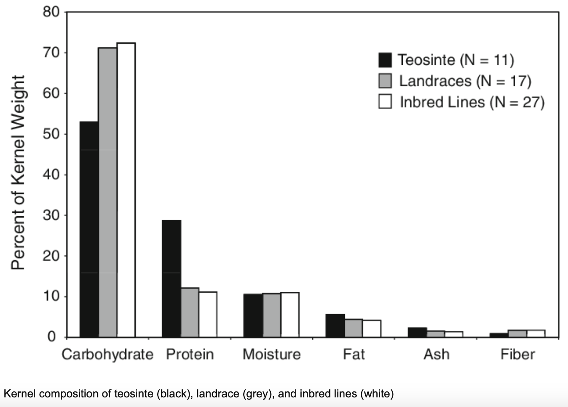
Maize Domestication and gut traits change during digestion
Source: Flint-Garcia, Sherry & Bodnar, Anastasia & Scott, Paul. (2009). Variability in Seed Characteristics, Kernel Quality, and Zein Profiles Among Diverse Maize Inbreds, Landraces, and Teosinte. Theoretical and Applied Genetics. 119. 1129-1142. 10.1007/s00122-009-1115-1.
Notes:
Maize (Zea mays ssp. mays), one of the most important commercial crops in the world nowadays, is domesticated from a wild weed, teosinte (Zea mays ssp. parviglumis), in Mexico more than 7000 years ago.(Flint-Garcia, 2013). During the domestication process, 2 to 4 percent of the maize genome were changed to meet the better agriculture perspective, while suffering the loss of genetic diversity. There are significant nutrition content differences between teosinte and landrace, especially the increase of starch content and decrease the protein content during domestication.
The gut microbiome plays a critical role in host health, influencing digestion, immune response, and even behavior. The hypothesis driving this study is that teosinte and landrace maize differentially shape gut microbiome diversity and composition, leading to distinct microbial community structures potentially. I in following, I will investigate how maize and teosinet differently shift gut microbiomes and the use the populaitonand Maize seeds were grinder into power before the digestion process. After the oral digestion, stomach digestion and small intestine digestion&dialylsis, seeds were treated with fecal samples to simulate the fermentation process. Then gut microbiome DNA extraction and 16S sequencing were done before further analysis.

Slide 2
Material and Methods
Yij= μ + Mi + Lj + eij (16S analysis model)
Block by human microbiome
Completely Randomized Design
25 teosinte lines and 25 maize lines
Align lines to the B73 reference genome, only the first 100kb on chromosome one
Bcf tools to call for the SNPs. Then calculate the Fst values
Angsd tool to calculate the theta values.
GBLUP matric is used while using rMVP package.

Slide 3
Microbiome Diversity and Abundance comparison between landrace and teosinte
(A)
(C)
(B)
Notes:
For the plot A, four different methods (Shannon, Chao1, Simpson, PD) for testing alpha diversity are used. All four methods show significant alpha diversity difference between landrace and teosinte gut microbiome. (B) The gut microbiome distance is calculated by four different methods (BC, Jaccard, unifrac, weighted unifrac). Then the principal component analysis (PCoA) was done and the first two components were used to show the beta diversity for landrace and teosinte in four different distance metrics. The landrace and teosinte shapes microbiome beta diversity into different directions. (C) FBB0 represents fecal buffer blank at time 0, FBB16 represents fecal buffer blank after 16 hours fermentation. Gut microbiome average relative abundance was calculated for each of the sample levels (FBB0, FBB16, Landrace, Teosinte). After fermentation, the Bacteroidaceae relative abundance is prompted in the landrace treatment, while the Prevotellaceae and Tannerellaceae relative abundance is much larger in the teosinte treatment.

Slide 4
Visualization of PERMANOVA Test Results
Notes:
A Permutational Multivariate Analysis of Variance (PERMANOVA) test was conducted across sample groups to identify genera with significantly different abundances. Log10 transformed abundance ratios were calculated for each genus, and the resulting values were plotted on a heatmap. The warmer the color, the higher the abundance. The taxa are classified based on their co-occurrence patterns across all samples, while the samples are grouped based on their similarity in microbial community composition. From the heatmap, the all teosinte lines show higher abundance for Dialister, UCG-002, Subdoligranulum, Bifidobacterium, Faecalibacterium, Phascolarctobacterium, Odoribacter, Holdemanella, and Butyricimonas abundance.

Slide 5
Two most group separating components from PLS-DA
Each of the component 1 and component 2 is a linear combination of the original pathways that maximally separates the two groups.
Component 1 captures the most groups-separating variance while, component 2 captures the second most

Slide 6
Pathways based on PLS-DA
PLS-DA test was done to selected the top 50 most differentiating pathways between landrace and teosinte.

Slide 7
Pathways based on Random Forest
Random Forest test was done to selected the top 50 most feature importance pathways by evaluating how influential each pathway was across all pathways.

Slide 8
Fst values frequency and values across chromosome one 100kbp between teosinte and landrace
(A)
(B)
Figure 3: Fst values frequency and values across chromosomes between teosinte and landrace. (A) The Fst values between the teosinte and landrace chromosomes were calculated. The frequency for the Fst values is shown by the y axis. (B) The Fst values were calculated across the chromosomes to assess genetic differentiation between teosinte and landrace. The x-axis represents chromosomal positions, and the y-axis shows the corresponding Fst values.
Notes:
The Fst values between maize and teosinte change from 0-0.3, with the highest frequency on 0.1. Suggesting a relative low overall genetic differentiation between maize and teosinte. The loci with relative large differentiation indicates selection during domestication or adaptation. For example, the red marked loci on figure B.

Slide 9
Tajima’s D values in teosinte and landrace
(A)
Figure 4: Tajima’s D values across the first 100000 base pairs(bp) of chromosome one in teosinte and landrace. The x axis represents the position in kilobases, while the y axis shows the corresponding Tajima’s D values. In both teosinte and landrace, Tajima’s D values are generally positive or near zero, consistent with signals of neutral evolution or balancing selection or bottleneck. The overall pattern of Tajima’s D is similar between the two, indicating shared evolutionary dynamic in this genomic region. However, landrace displaces a pronounced peak around 38 kb compared to teosinte, suggesting a stronger balancing selection in landrace at this locus.
(B)

Slide 10
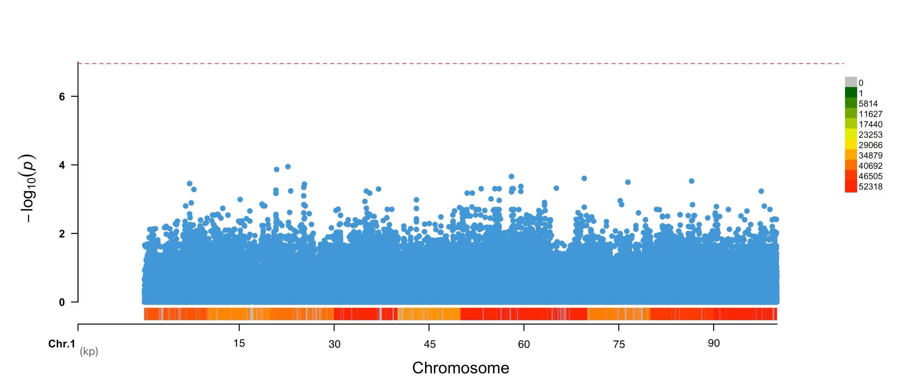
Genome-wide association analysis between maize landrace and Bifidobacteria Relative Abundance
Figure 5: Genome-wide association analysis across 100000bp on chromosome one. The Manhattan plot shows the -log₁₀(p) values of SNP associations across the first 100 kb of chromosome one. The bottom panel displays a heatmap indicating SNP density, with warmer colors representing higher values.
Notes:
No genome-wide significant SNPs (none exceed the dashed red line). The possible reason is only a partical genome were used in the analysis. In the future Whole genome GAWS will be done. Also, the gene enrichment analysis and pathway analysis is needed to tell the story, since the microbiome abundance data is not enough to explain everything,. Perform KEGG Ontology (KO) enrichment analysis to identify overrepresented functional genes in the gut microbiome, KEGG pathway analysis to assess enriched metabolic pathways, and dbCAN3 analysis to investigate genes involved in carbohydrate metabolism. After predicting the pathways and the causal nutrition components, analyzing the metabolite content (e.g., phenolics, fibers, lipids) in teosinte and landrace kernels as a validation process.

